Slide 1
iFS i-node file system implementation

Slide 2
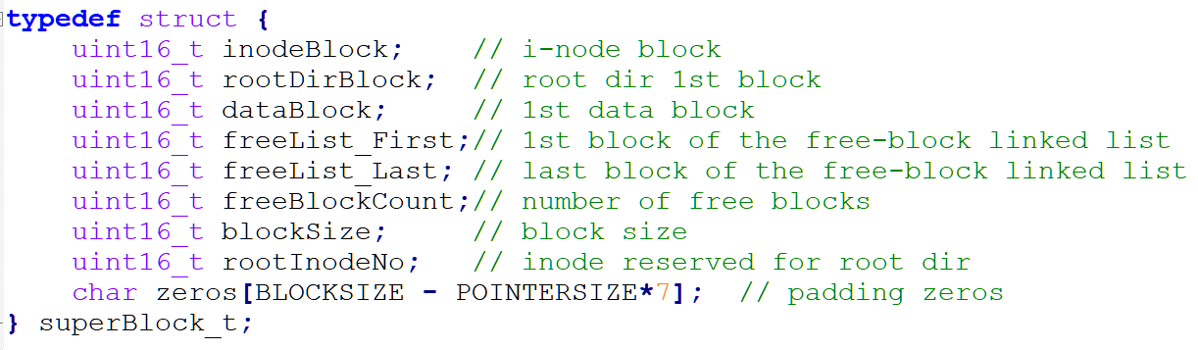
0
Boot block
1
Super block
2
Inode table
3
Root dir
1st free node
...
Last free node
Data block
...

Slide 3
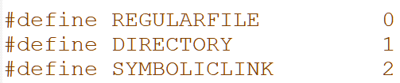
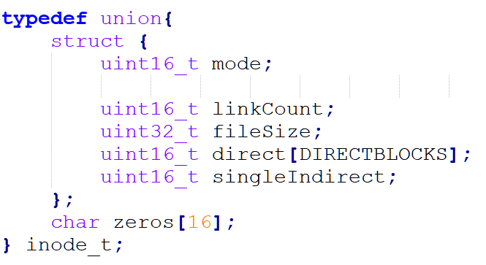
0
Boot block
inode
1
Super block
2
Inode table
4 highest significant bits
3
Root dir
1st free node
...
Last free node
Data block
...

Slide 4
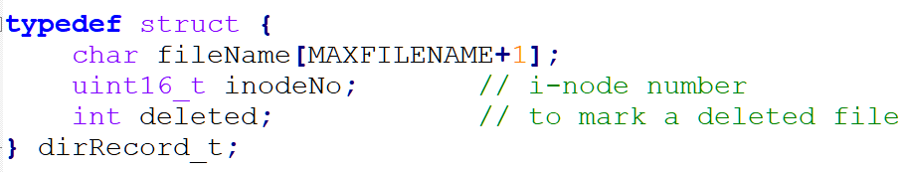
0
Boot block
File entry
1
Super block
2
Inode table
3
Root dir
1st free node
...
Last free node
Data block
...

Slide 5
0
Boot block
List of free blocks – 1st linked list node
1
Super block
1st node is loaded to memory
2
Inode table
3
Root dir
Next linked list node...
Other nodes are kept on disk
1st free node
List of free blocks – 1st linked list node
...
k
Last node is loaded to memory
Last free node
Data block
If <> 0 then entry k is a free block
If ==0 means this entry has been removed from the free list
...
Memory structure to keep 1st and last nodes:

Slide 6
iFS modules
Shell program (fsshell.c)
A command line shell to access the file system
I-node file system (fs.c)
Mount, format, unmount file system
Create, open, close, read, write etc. to files
Disk emulation (diskemu.c)
Read/write disk blocks
Make disk
Disk image file (diskimage)

Slide 7
Assigment
Shell program (fsshell.c)
I-node file system (fs.c)
Write a new function fs_checkDisk() in checkdisk.c module. This file will be included as part of fs.c during the compilation.
checkDisk.c
Disk emulation (diskemu.c)
Disk image file (diskimage)

